Slide 1
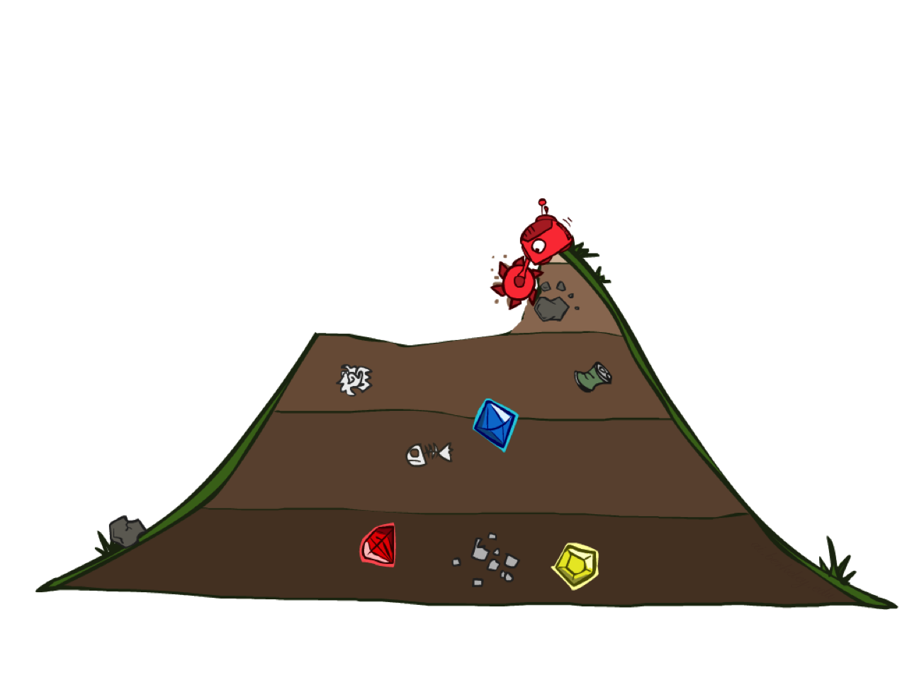

Uniform Cost Search

Slide 2
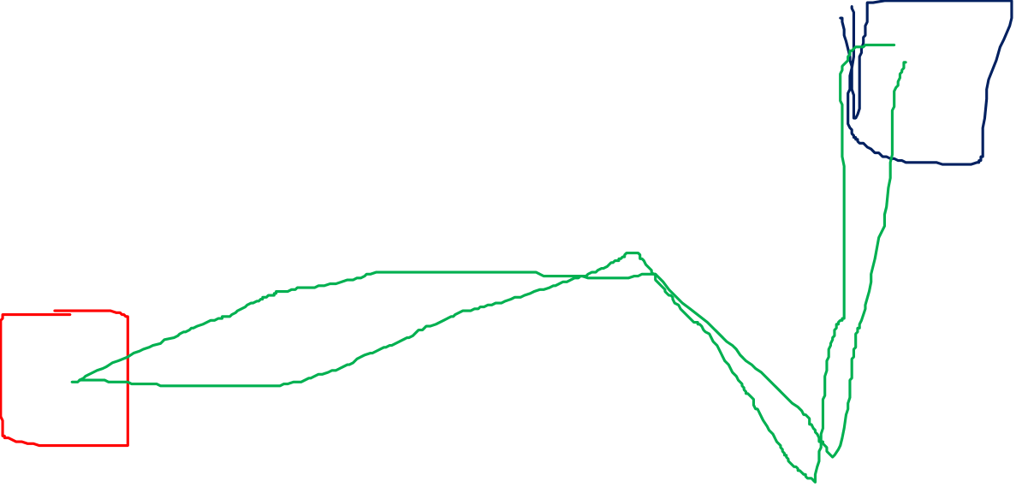
Cost-Sensitive Search
a
GOAL
2
2
b
c
3
2
1
8
2
e
d
f
3
9
8
2
START
h
1
4
2
p
4
r
15
q
BFS finds the shortest path in terms of number of actions.
It does not find the least-cost path. We will now cover
a similar algorithm which does find the least-cost path.

Slide 3

Uniform Cost Search
2
G
a
Strategy: expand a cheapest node first:
Fringe is a priority queue (priority: cumulative cost)
b
c
1
8
2
2
e
3
d
f
9
8
2
S
h
1
1
p
q
r
15
0
S
d
3
e
9
p
1
b
4
e
5
h
17
r
11
q
16
c
11
Cost contours
a
6
a
h
13
r
7
p
q
f
p
q
f
8
q
c
G
q
c
a
11
G
10
a

Slide 4
Uniform Cost Search (UCS) Properties
What nodes does UCS expand?
Processes all nodes with cost less than cheapest solution!
If that solution costs C* and arcs cost at least ε , then the “effective depth” is roughly C*/ε
Takes time O(b^{C*/ε}) (exponential in effective depth)
How much space does the fringe take?
Has roughly the last tier, so O(b^{C*/ε})
Is it complete?
Assuming best solution has a finite cost and minimum arc cost is positive, yes!
Is it optimal?
Yes! (Proof next lecture via A*)
b
c ≤ 1
…
C*/ε “tiers”
c ≤ 2
c ≤ 3

Slide 5

Uniform Cost Issues
Remember: UCS explores increasing cost contours
The good: UCS is complete and optimal!
The bad:
Explores options in every “direction”
No information about goal location
We’ll fix that soon!
…
c ≤ 1
c ≤ 2
c ≤ 3
Start
Goal
[Demo: empty grid UCS (L2D5)]
[Demo: maze with deep/shallow water DFS/BFS/UCS (L2D7)]

Slide 6

The One Queue
All these search algorithms are the same except for fringe strategies
Conceptually, all fringes are priority queues (i.e. collections of nodes with attached priorities)
Practically, for DFS and BFS, you can avoid the log(n) overhead from an actual priority queue, by using stacks and queues
Can even code one implementation that takes a variable queuing object

Slide 7
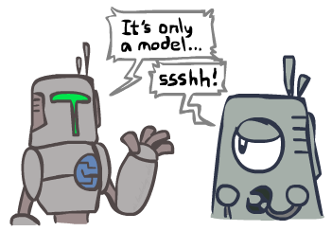
Search and Models
Search operates over models of the world
The agent doesn’t actually try all the plans out in the real world!
Planning is all “in simulation”
Your search is only as good as your models…

